Slide 1

RESTful - Web Services and APIs Development
Trainer igor.mitkovski@gmail.com
Assistant dejan.pblazheski@seavus.com

Slide 2
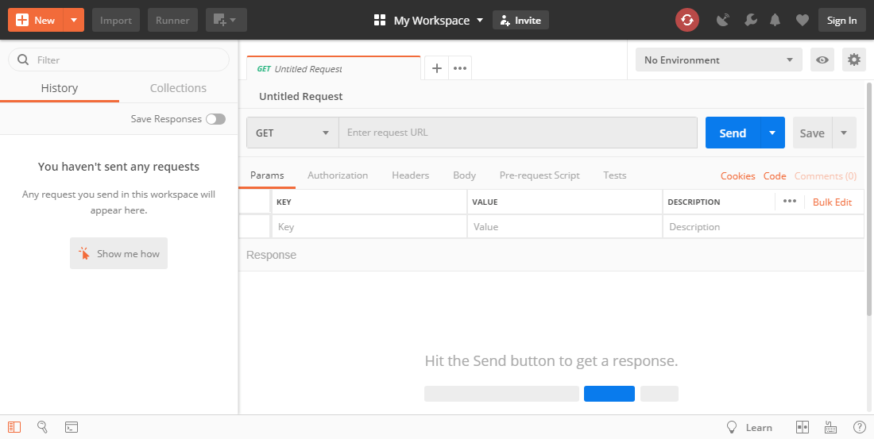
Postman
ASP.NET WEB API
https://www.getpostman.com/
Code academy @ Skopje, 2018-2019

Slide 3
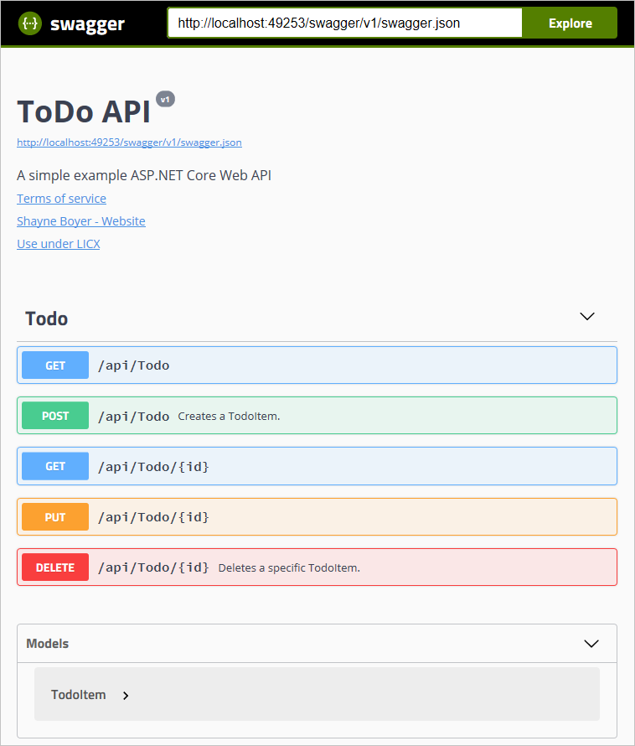
Swagger
ASP.NET WEB API
https://docs.microsoft.com/en-us/aspnet/core/tutorials/getting-started-with-swashbuckle?view=aspnetcore-2.2&tabs=visual-studio
Code academy @ Skopje, 2018-2019

Slide 4
?
ASP.NET WEB API
Code academy @ Skopje, 2018-2019

